Slide 1
Planning to Grow: From Seed to Sold
Presented by Kacey Gantzer Northern WV Agriculture Business Planning Coordinator

Slide 2
Where to start?
WHO – is the customer or consumer
WHERE – will they purchase the product and how
WHEN – is the ideal/target harvest
WHY – am I growing…. Home consumption (healthy foods & therapeutic), to share with others, extra income, part time business, full time career
How- use prior sales and production notes

Slide 3
Market Research
Who are your primary customers?
Identify a customer group you would like to capture.

Slide 4
Group Market Planning
Pre-Planning Grower Survey
(post season review)
Items that regularly sold out
Produce customers requested and market had limited or no availability
Best Selling Produce

Slide 5
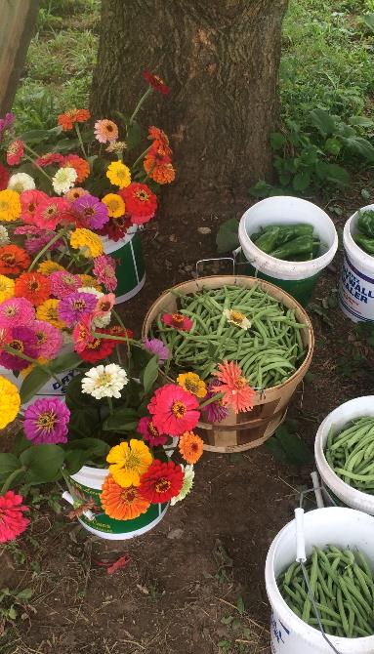
Before You Grow
Maximize Space (companion planting, succession planting, season extension)
Record Keeping (guide to future growing)
Protection (fencing, preventative sprays, irrigation, trellising, caging, weed suppression)
Seed Selection, find what works best for your goals
Soil Test*
Harvest and storage plans

Slide 6
Now What… “What Should I grow”
Let your pre-planning be the guide
Diversity is key for small operations
Know your costs and value of crops for your area
Value Added Products
Niche Market Growing
You are an Added Value!! WV Grown, Home Grown By Heroes, Certified Naturally Grown, etc.
Grow what you love and are comfortable with growing

Slide 7
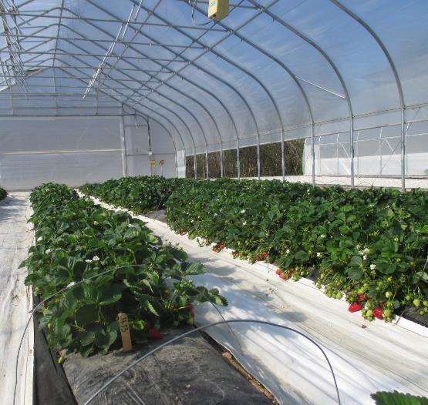
Seed to Sold Building the Plan
Sourcing, Seeding, and Transplants
Land-prep and Planting
Growing, Pest Control, Fertilization
Harvest (Food Safety), Packing, Storage
Marketing, Sales, and Tracking

Slide 8
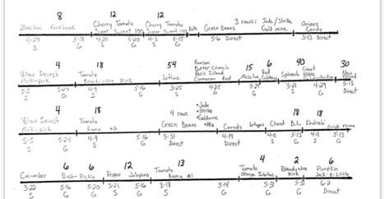
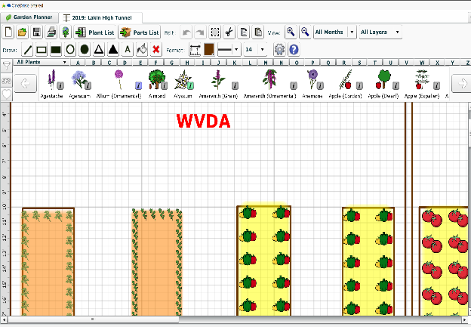
Planning Tools: Apps, Written, Online, Excel

Slide 9
Production Planning on Excel

Slide 10
Questions?
Contact:
Kacey Gantzer 304.546.9167
Email: Kgantzer@wvda.us

